Slide 1
Car Dheko - Used Car Price Prediction
Goodwin Blesso I
mdt - 38

Slide 2
Introduction
Problem Statement:
The used car market is vast, and pricing inconsistencies make it difficult for customers to make informed decisions.
Objective:
To enhance customer experience by providing a reliable price prediction tool.
Develop an accurate and user-friendly Streamlit application for used car price prediction.
Benefits:
Instant Price Estimates: Helps customers determine their car's price instantly.
Transparent Pricing: Enables better understanding of price variations.

Slide 3
Overview
Dataset:
Data Source: Historical data from CarDekho
Features: km, ownerNo, Manufacturer, Engine Displacement, Mileage, Seats, No of Cylinder, No Door Numbers, City, Fuel Type, Body Type, Transmission
Target: price
Dataset Size: 8369 records
Data Preprocessing:
Convert the unstructured data to structured data.
Data Type Conversion & Standardising Data Formats.
Missing Value Treatment:
Numerical columns: Mode imputation
Categorical columns: Mode imputation
Outlayer Treatment: Identified and capped the outlayers using the IQR (Interquartile Range) method.
Encoding: Used One-hot encoding and binary encoding techniques for categorical columns.
Normalization: Used “MinMaxScaler” technique to normalize the numerical columns.
Feature Selection: Used “RandomForestRegressor” to select the features based on the contributions.

Slide 4
EDA:
It involves analyzing and visualizing data to understand its structure, detect patterns, and identify anomalies.
Insights:
City-Wise Distribution:
Bangalore, Delhi, and Hyderabad have the highest number of cars, each exceeding 1,400 listings.
Fuel Type:
Petrol cars dominate the market, making up the majority of available listings.
Body Type:
The Hatchback category is the most prevalent among all body types.
Ownership History:
First-owner cars are the most common in the market.
Brand Popularity:
Maruti, Hyundai, and Honda lead in car availability.
Transmission Type:
Manual transmission cars outnumber automatic ones.
Seating Capacity:
Cars with 5 seats are the most widely available.
Steering Type:
Power steering is the most common feature in listed cars.

Slide 5
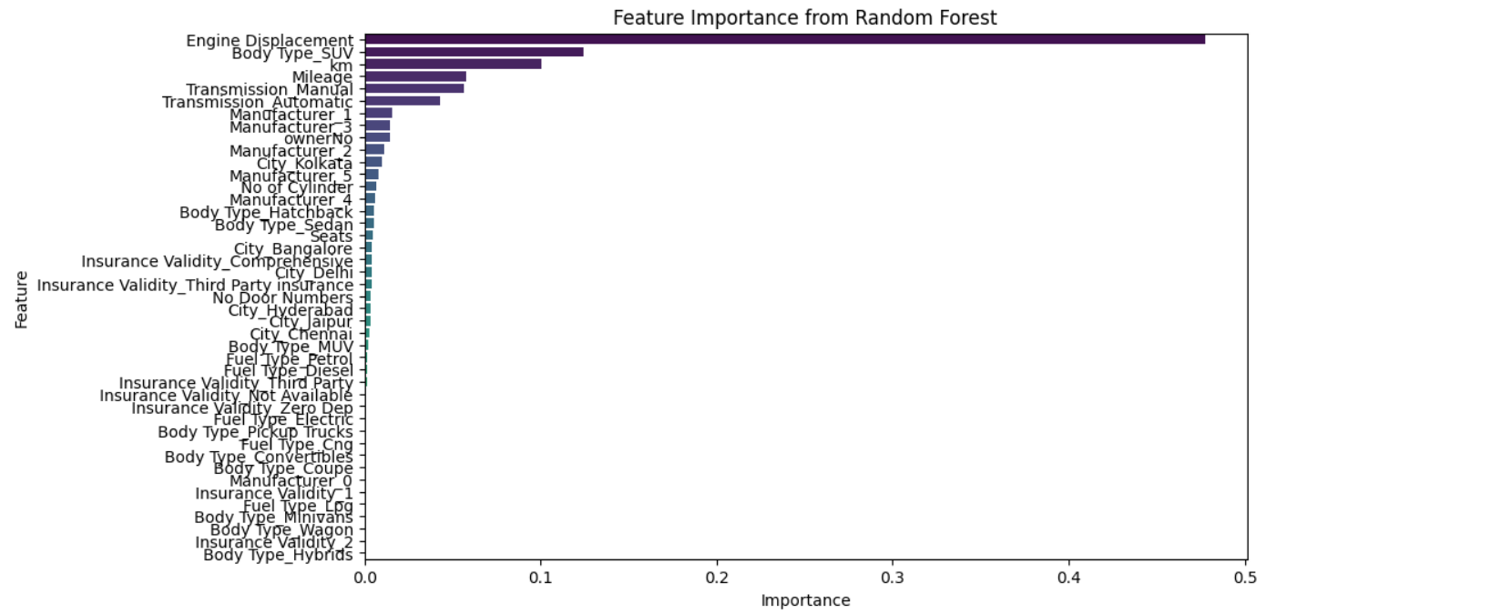
Important Features:

Slide 6
Model Development:
Algorithm Used: XGBoost (Boosting Algorithm), this algorithm was chosen for its way of efficiently handles the complex relationship used in car pricing.
Data split: train_test_split method (Training: 70%, Testing: 30%).
Model Evaluation:
Metrics: Mean Absolute Error, Mean Squared Error, R-squared.
Scores:
Algorithms | MAE | MSE | R2
Linear Regression | 186406.610 | 61863516323.24 | 0.74
Decision Tree | 180118.96 | 63833384219.74 | 0.73
Random Forest | 110032.83 | 31773064488.00 | 0.86
Gradient Boosting | 143065.89 | 41712951781.26 | 0.82
XG Boosting | 100282.78 | 26481869136.22 | 0.89

Slide 7
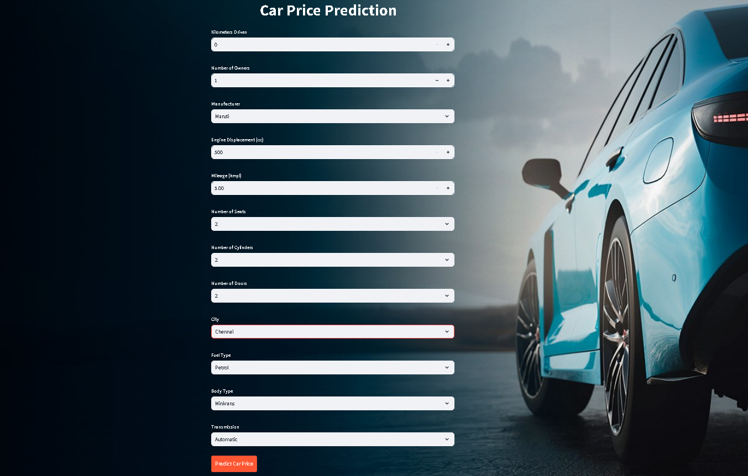
Deployment:
Streamlit Application: Deploy the final model using Streamlit and created an interactive web application, the user interface looks as below:

Slide 8
Workflow:
Accessing the Application
Run the steamlit application using the command “streamlit run app.py”
It redirects to the web browser and navigate to the Price Prediction app.
Enter Car Details
Kilometers Driven: Enter the total distance the car has been driven.
Number of Owners: Select the number of previous owners.
Manufacturer: Choose the car brand (e.g., Maruti, Hyundai, Toyota).
Engine Displacement (cc): Enter the engine size in cubic centimeters.
Mileage (kmpl): Provide the mileage of the car.
Number of Seats: Select the number of passenger seats.
Number of Cylinders: Choose the number of engine cylinders.
Number of Doors: Specify the number of doors in the car.
City: Select the location where the car is being sold.
Fuel Type: Choose between Petrol, Diesel, CNG, or Electric.
Body Type: Select the car’s body style (Sedan, SUV, Hatchback, etc.).
Transmission: Choose between Manual and Automatic.
Submit the Form
Once all fields are filled, click on the "Predict Car Price" button.
The application processes the inputs and displays the estimated price of the car instantly.

Slide 9
Challenges Faced:
Data Transformation: Converting unstructured data into structured format.
Categorical Encoding: Handling categorical columns with a high number of unique values.
Standardization: Ensuring consistency in data formats across different features.
Feature Selection: Identifying the most significant features influencing car prices.
Hyper parameter Tuning: Optimizing model parameters to enhance accuracy.
Data Preprocessing in Deployment: Extracting raw values from the Streamlit UI and transforming them to match the model’s training format.
Conclusion:
Developed a machine learning model to predict used car prices accurately.
Successfully, integrated it into a user-friendly Streamlit application.

Slide 10
Thank You

